Slide 1
Chapter 8
Callback Interfaces, Delegates, and Events.

Slide 2
Objectives
Understanding two-way conversion
Using callback interfaces, delegates and events

Slide 3
Objectives
Understanding the .NET Delegate Type
Defining a Delegate in C#
Multicast Delegates
Understanding Delegate Covariance
Understanding C# Events
Understanding C# anonymous methods

Slide 4
Understanding the .NET Delegate Type
A delegate is a type-safe object that points to another method
A delegate type maintains three important pieces of information:
  The name of the method on which it makes calls
  The arguments (if any) of this method
  The return value (if any) of this method

Slide 5
Defining a Delegate in C#
// This delegate named BinaryOp can point to any method,
// taking two integers and returning an integer.
public delegate int BinaryOp(int x, int y);

Slide 6
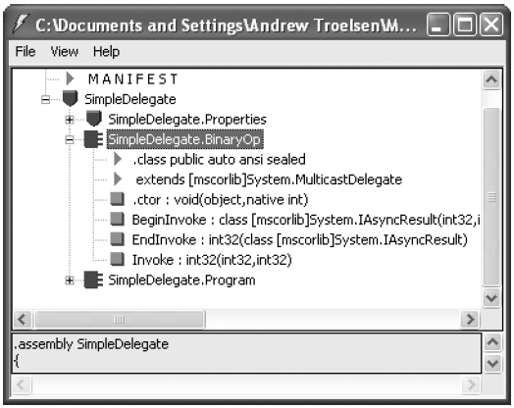
Defining a Delegate in C#
The C# delegate keyword represents a sealed type deriving from System.MulticastDelegate.

Slide 7
Multicast Delegates
A delegate object can maintain a list of methods to call
The overloaded += operator, the static Delegate.Combine() method
The overloaded -= operator, the static Remove() method

Slide 8
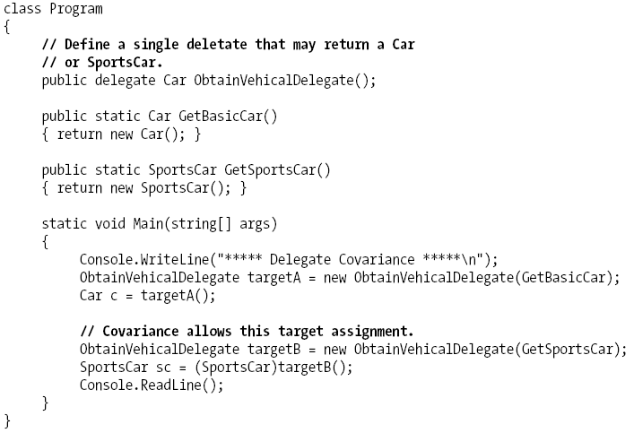
Understanding Delegate Covariance
Notes:
Covariance: hiệp phương sai

Slide 9
Understanding Delegate Covariance
Covariance allows you to create a single delegate that can point to numerous methods that receive objects related by classical inheritance.

Slide 10
Understanding C# Events
Working with delegates in the raw does entail a good amount of boilerplate code
Using event keyword, you are automatically provided with registration and unregistration methods as well as any necessary member variable for your delegate types.
Defining an event is a two-step process:
  First, you need to define a delegate that contains the methods to be called when the event is fired.
  Next, you declare the events (using the C# event keyword) in terms of the related delegate.

Slide 11
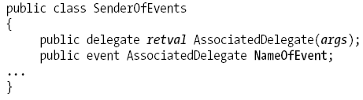
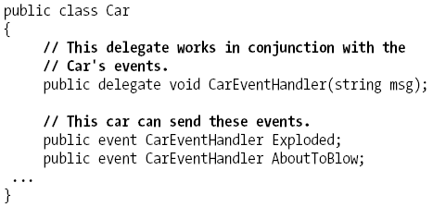
Understanding C# Events
pattern
Example

Slide 12
public void Accelerate(int delta)
{
// If the car is dead, fire Exploded event.
if (carIsDead)
{
if (Exploded != null)
Exploded("Sorry, this car is dead...");
}
else
{
currSpeed += delta;
// Almost dead?
if (10 == maxSpeed - currSpeed
&& AboutToBlow != null)
{
AboutToBlow("Careful buddy! Gonna blow!");
}
// Still OK!
if (currSpeed >= maxSpeed)
carIsDead = true;
else
Console.WriteLine("->CurrSpeed = {0}", currSpeed);
}
}
Notes:
1) Sending an event to the caller is as simple as specifying the event by name as well as any required parameters as defined by the associated delegate
2) To ensure that the caller has indeed registered with event, you will want to check the event against a null value before invoking the delegate’s method set

Slide 13

Car c1 = new Car("SlugBug", 100, 10);
// Register event handlers.
c1.AboutToBlow += new Car.CarEventHandler(CarIsAlmostDoomed);
c1.AboutToBlow += new Car.CarEventHandler(CarAboutToBlow);
Car.CarEventHandler d = new Car.CarEventHandler(CarExploded);
c1.Exploded += d;
Console.WriteLine("\n***** Speeding up *****");
for (int i = 0; i < 6; i++)
c1.Accelerate(20);
// Remove CarExploded method from invocation list.
c1.Exploded -= d;
Console.WriteLine("\n***** Speeding up *****");
for (int i = 0; i < 6; i++)
c1.Accelerate(20);
Console.ReadLine();
}
public static void CarAboutToBlow(string msg)
{ Console.WriteLine(msg); }
public static void CarIsAlmostDoomed(string msg)
{ Console.WriteLine("Critical Message from Car: {0}", msg); }
public static void CarExploded(string msg)
{ Console.WriteLine(msg); }
}
Notes:
C# events also simplify the act of registering the caller-side event handlers. Rather than having to
specify custom helper methods, the caller simply makes use of the += and -= operators directly

Slide 14
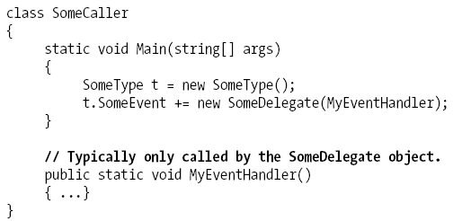
Understanding C# Anonymous methods

Slide 15
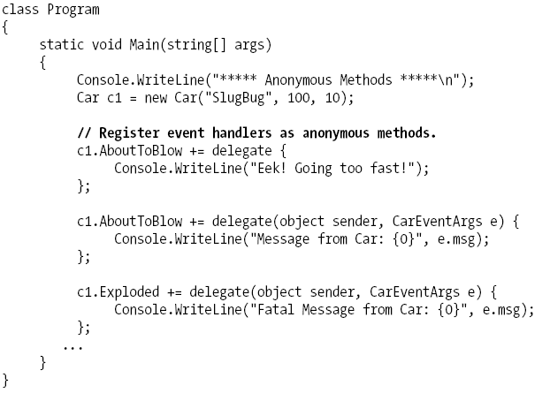
Understanding C# Anonymous methods

Slide 16
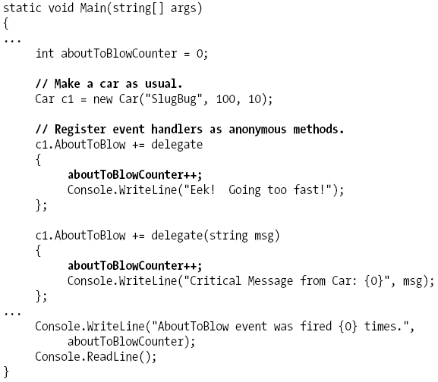
Understanding C# Anonymous methods
Accessing “Outer”Variables

Slide 17
Summary
Examining a number of ways in which multiple objects can partake in a bidirectional conversion
Delegates and Events

Slide 18
Q & A

